Slide 1
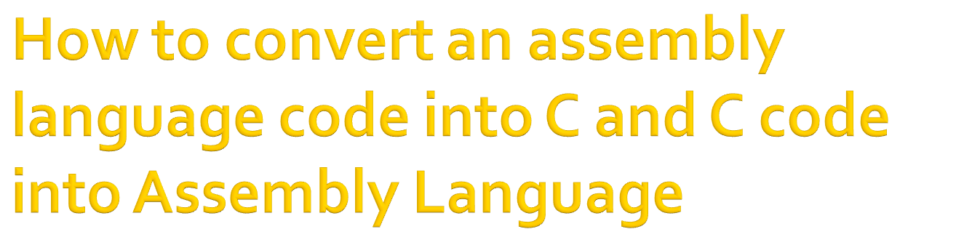

By: Ali Hassan Soomro
BSCS from UBIT, University of Karachi
DAE in Electronics from SBTE
Facebook: https://web.facebook.com/AliiHassanSoomro
Gmail: alisoomro666@gmail.com

Slide 2

Programming model
Assembly language
  Assembly code structure / Data Types
  Assembly instructions
C/C++
  Data types
  Intrinsic functions
  Optimizations
  Software Pipelining
  Inline Assembly
  Calling Assembly functions

Slide 3

Two register files: A and B
16 registers in each register file (A0-A15), (B0-B15)
A0, A1, B0, B1 used in conditions
A4-A7, B4-B7 used for circular addressing

Slide 4

A TMS320C6x assembly instruction includes up to seven items:
  Label
  Parallel bars
  Conditions
  Instruction
  Functional unit
  Operands
  Comment
  Format of assembly instruction:
  Label: parallel bars [condition] instruction unit operands ;comment

Slide 5

|| : indicates that current instruction executes in parallel with previous instruction, otherwise left blank

Slide 6

All assembly instructions are conditional
If no condition is specified, the instruction executes always
If a condition is specified, the instruction executes only if the condition is valid
Registers used in conditions are A1, A2, B0, B1, and B2
Examples:
  [A] ;executes if A ≠ 0
  [!A] ;executes if A = 0
  [B0] ADD .L1 A1,A2,A3
  || [!B0] ADD .L2 B1,B2,B3

Slide 7
Either directive or mnemonic
Directives must begin with a period (.)
Mnemonics should be in column 2 or higher
Examples:
.sect data ;creates a code section
.word value ;one word of data

Slide 8
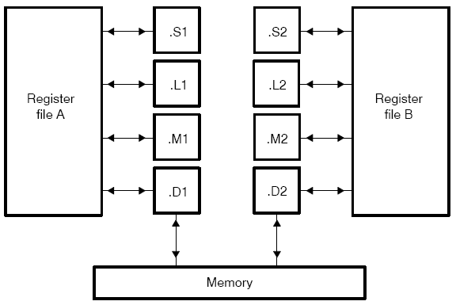
L units: 32/40 bit arithmetic/compare and 32 bit logic operations
S units: 32-bit arithmetic operations, 32/40-bit shifts and 32-bit bit-field operations, 32-bit logical operations, Branches, Constant generation, Register transfers to/from control register file (.S2 only)
M units: 16 x 16 multiply operations
D units: 32-bit add, subtract, linear and circular address calculation, Loads and stores with 5-bit constant offset, Loads and stores with 15-bit constant, offset (.D2 only)

Slide 9

All instructions require a destination operand.
Most instructions require one or two source operands.
The destination operand must be in the same register file as one source operand.
One source operand from each register file per execute packet can come from the register file opposite that of the other source operand.
Example:
  ADD .L1 A0,A1,A3
  ADD .L1 A0,B1,A2

Slide 10

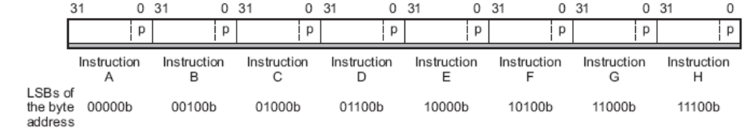
Fetch packet
The same functional unit cannot be used in the same fetch packet
  ADD .S1 A0, A1, A2 ;.S1 is used for
  || SHR .S1 A3, 15, A4 ;...both instructions

Slide 11

Add/subtract/multiply:
ADD .L1 A3,A2,A1 ;A1←A2+A3
SUB .S1 A1,1,A1 ;decrement A1
MPY .M2 A7,B7,B6 ;multiply LSBs
|| MPYH .M1 A7,B7,A6 ;multiply MSBs

Slide 12

Loading constants:
MVK .S1 val1, A4 ;move low halfword
MVKH .S1 val1, A4 ;move high halfword
Indirect Addressing Mode:
LDH .D2 *B2++, B7 ;load halfword B7←[B2], increment B2
|| LDH .D1 *A2++, A7 ; load halfword A7←[A2], increment A2
STW .D2 A1, *+A4[20] ;store [A4]+20 words ← A2, ;preincrement/don’t modify A4

Slide 13
Calculate the values of register and memory for the following instructions:
A2= 0x00000010, MEM[0x00000010] = 0x0, MEM[0x00000014] = 0x1, MEM[0x00000018] = 0x2, MEM[0x0000001C] = 0x3,
LDH .D1 *++A2, A7 A2= ? A7= ?
LDH .D1 *A2--[2], A7 A2= ? A7= ?
LDH .D1 *-A2, A7 A2= ? A7= ?
LDH .D1 *++A2[2], A7 A2= ? A7= ?

Slide 14

Loop example:
MVK .S1 count, A1 ;loop counter
|| MVKH .S2 count, A1
LOOP MVK .S1 val1, A4 ;loop MVKH .S1 val1, A4 ;body
SUB .S1 A1,1,A1 ;decrement counter
[A1] B .S2 Loop ;branch if A1 ≠ 0
NOP 5 ;5 NOPs for branch

Slide 15

.short : initiates 16-bit integer
.int (.word .long) : initiates 32-bit integer
.float : 32-bit single-precision floating-point
.double : 64-bit double-precision floating-point
.trip :
.bss
.far
.stack

Slide 16

Data types
Intrinsic functions
Inline assembly
Linear assembly
Calling assembly functions
Code optimizations
Software pipelining

Slide 17
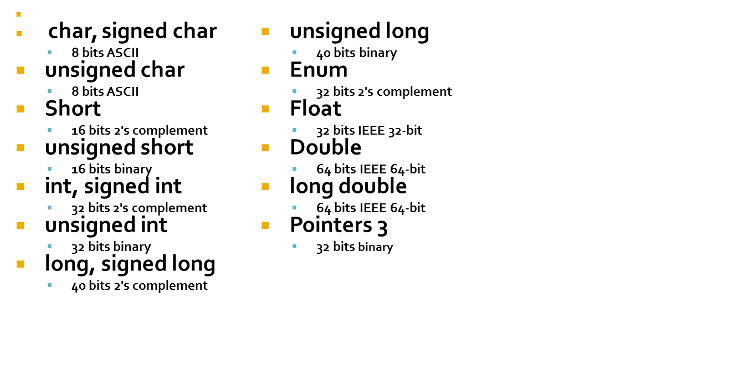

Slide 18

Available C functions used to increase efficiency
  int_mpy(): MPY instruction, multiplies 16 LSBs
  int_mpyh(): MPYH instruction, multiplies 16 MSBs
  int_mpylh(): MPYHL instruction, multiplies 16 LSBs with 16 MSBs
  int_mpyhl(): MPYHL instruction, multiplies 16 MSBs with 16 LSBs

Slide 19

Assembly instructions and directives can be incorporated within a C program using the asm statement
  asm (“assembly code”);

Slide 20

An external declaration of an assembly function can be called from a C program
extern int func();

Slide 21
Program that calculates S=n+(n-1)+…+1 by calling assembly function
#include <stdio.h>
main()
{
short n=6;
short result;
result = sumfunc(n);
printf(“sum = %d”, result);
}

Slide 22

Assembly function:
.def _sumfunc
_sumfunc: MV .L1 A4,A1 ;n is loop counter
SUB .S1 A1,1,A1 ;decrement n
LOOP: ADD .L1 A4,A1,A4 ;A4 is accumulator
[A1] B .S2 LOOP ;branch if A1 ≠ 0
NOP 5 ;branch delay nops
B .S2 B3 ;return from calling
NOP 5 ;five NOPS for delay
.end

Slide 23

Write a program that calculates the first 6 Fibonacci numbers by calling an assembly function

Slide 24

enables writing assembly-like programs without worrying about register usage, pipelining, delay slots, etc.
The assembler optimizer program reads the linear assembly code to figure out the algorithm, and then it produces an optimized list of assembly code to perform the operations.
Source file extension is .sa
The linear assembly programming lets you:
  use symbolic names
  forget pipeline issues
  ignore putting NOPs, parallel bars, functional units, register names
  more efficiently use CPU resources than C.

Slide 25

_sumfunc: .cproc np ;.cproc directive starts a C callable procedure
.reg y ;.reg directive use descriptive names for values that will be stored in registers
MVK np,cnt
loop: .trip 6 ; trip count indicates how many times a loop will iterate
SUB cnt,1,cnt
ADD y,cnt,y
[cnt] B loop
.return y
.endproc ; .endproc to end a C procedure
---------------------Equivalent assembly function------------------------------
.def _sumfunc
_sumfunc: MV .L1 A4,A1 ;n is loop counter
LOOP: SUB .S1 A1,1,A1 ;decrement n
ADD .L1 A4,A1,A4 ;A4 is accumulator
[A1] B .S2 LOOP ;branch if A1 ≠ 0
NOP 5 ;branch delay nops
B .S2 B3 ;return from calling
NOP 5 ;five NOPS for delay
.end

Slide 26
A loop optimization technique so that all functional units are utilized within one cycle. Similar to hardware pipelining, but done by the programmer or the compiler, not the processor
Three stages:
  Prolog (warm-up): instructions needed to build up the loop kernel (cycle)
  Loop kernel (cycle): all instructions executed in parallel. Entire kernel executed in one cycle.
  Epilog (cool-off): Instructions necessary to complete all iterations

Slide 27

Draw a dependency graph
  Draw nodes and paths
  Write number of cycles for each instruction
  Assign functional units
Set up a scheduling table
Obtain code from scheduling table

Slide 28

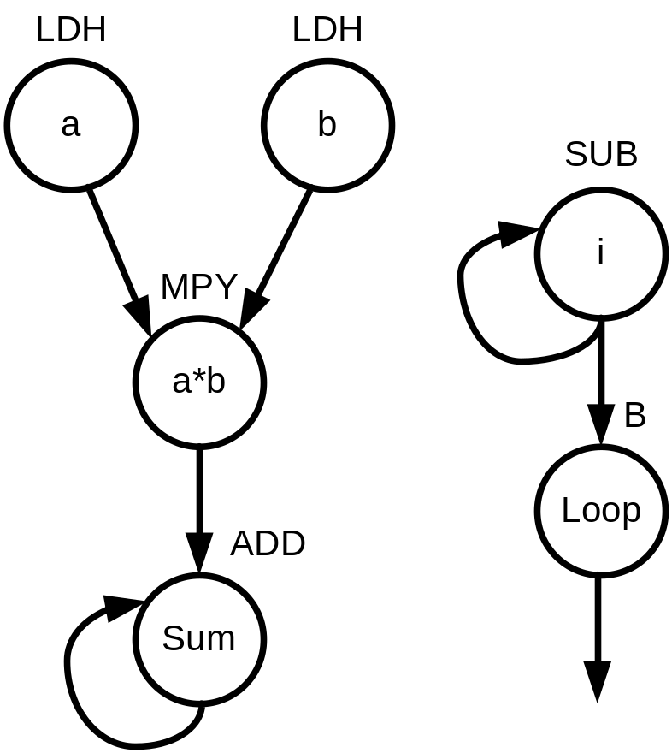
for (i=0; i<16; i++)
sum = sum + a[i]*b[i];

Slide 29

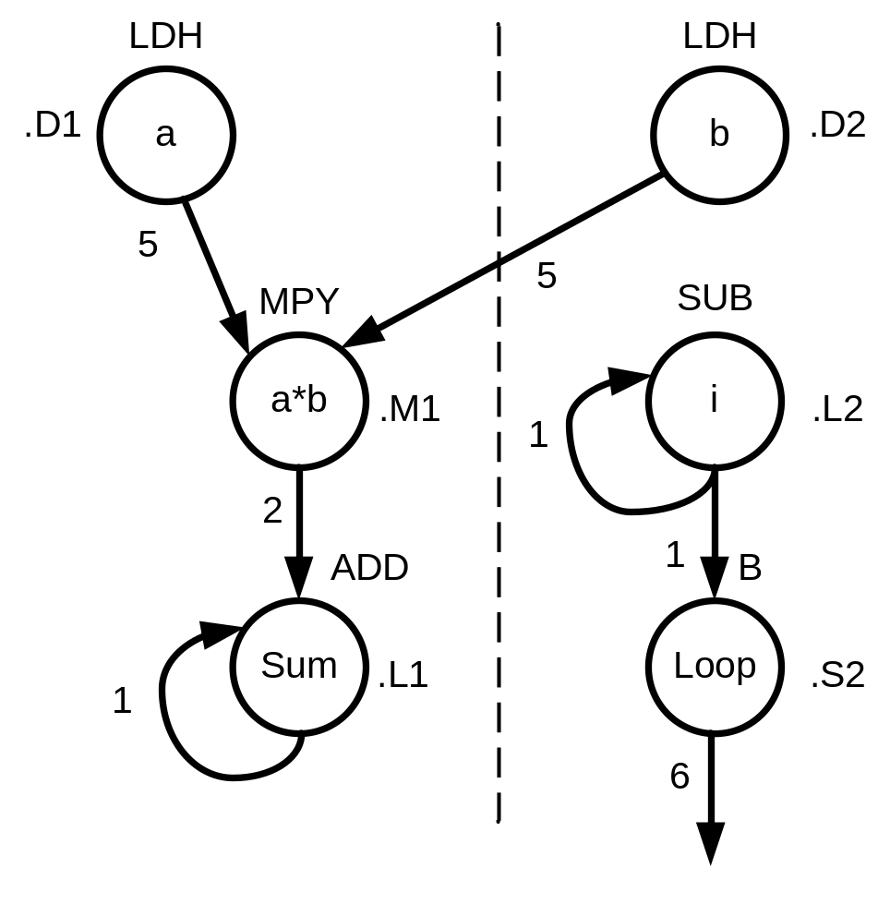
LDH: 5 cycles
MPY: 2 cycles
ADD: 1 cycle
SUB: 1 cycle
LOOP: 6 cycles

Slide 30
Unit | C1, C9.. | C2, C10… | C3, C11.. | C4, C12… | C5, C13… | C6, C14… | C7, C15… | C8, C16…
.D1 | LDH
.D2 | LDH
.M1 |  |  |  |  |  | MPY
.L1 |  |  |  |  |  |  |  | ADD
.L2 |  | SUB
.S2 |  |  | B
Unit | C1, C9.. | C2, C10… | C3, C11.. | C4, C12… | C5, C13… | C6, C14… | C7, C15… | C8, C16…
 | Prolog |  |  |  |  |  |  | Kernel
.D1 | LDH | LDH | LDH | LDH | LDH | LDH | LDH | LDH
.D2 | LDH | LDH | LDH | LDH | LDH | LDH | LDH | LDH
.M1 |  |  |  |  |  | MPY | MPY | MPY
.L1 |  |  |  |  |  |  |  | ADD
.L2 |  | SUB | SUB | SUB | SUB | SUB | SUB | SUB
.S2 |  |  | B | B | B | B | B | B

Slide 31
;cycle 1
MVK .L2 16,B1 ;loop count
|| ZERO .L1 A7 ;sum
|| LDH .D1 *A4++,A2 ;input in A2
|| LDH .D2 *B4++,B2 ;input in B2
;cycle 2
LDH .D1 *A4++,A2 ;input in A2
|| LDH .D2 *B4++,B2 ;input in B2
|| [B1] SUB .L2 B1,1,B1 ;decrement count
;cycle 3
LDH .D1 *A4++,A2 ;input in A2
|| LDH .D2 *B4++,B2 ;input in B2
|| [B1] SUB .L2 B1,1,B1 ;decrement
|| [B1] B .S2 LOOP
;cycle 4
LDH .D1 *A4++,A2 ;input in A2
|| LDH .D2 *B4++,B2 ;input in B2
|| [B1] SUB .L2 B1,1,B1 ;decrement
|| [B1] B .S2 LOOP
;cycle 5
LDH .D1 *A4++,A2 ;input in A2
|| LDH .D2 *B4++,B2 ;input in B2
|| [B1] SUB .L2 B1,1,B1 ;decrement
|| [B1] B .S2 LOOP

Slide 32

;cycle 6
LDH .D1 *A4++,A2 ;input in A2
|| LDH .D2 *B4++,B2 ;input in B2
|| [B1] SUB .L2 B1,1,B1 ;decrement
|| [B1] B .S2 LOOP
|| MPY .M1x A2,B2,A6
;cycle 7
LDH .D1 *A4++,A2 ;input in A2
|| LDH .D2 *B4++,B2 ;input in B2
|| [B1] SUB .L2 B1,1,B1 ;decrement
|| [B1] B .S2 LOOP
|| MPY .M1x A2,B2,A6
;cycles 8-21(loop kernel)
LOOP: LDH .D1 *A4++,A2 ;input in A2
|| LDH .D2 *B4++,B2 ;input in B2
|| [B1] SUB .L2 B1,1,B1 ;decrement
|| [B1] B .S2 LOOP
|| MPY .M1x A2,B2,A6 ;multiplication
|| ADD .L1 A6,A7,A7
;cycle 22 (epilog)
ADD .L1 A6,A7,A7 ;final sum

Slide 33
Use software pipelining in the following example:
for (i=0; i<16; i++)
sum = sum + a[i]*b[i];

Slide 34

A technique for reducing the loop overhead
The overhead decreases as the unrolling factor increases at the expense of code size
Doesn’t work with zero overhead looping hardware DSPs
for (i=0; i<64; i++)
{
sum +=*(data++);
}
for (i=0; i<64/4; i++)
{
sum +=*(data++);
sum +=*(data++);
sum +=*(data++);
sum +=*(data++);
}

Slide 35

Unroll the following loop by a factor of 2, 4, and eight
for (i=0; i<64; i++)
{
a[i] = b[i] + c[i+1];
}

Slide 36

When code performance is not satisfactory the following steps can be taken:
  Use intrinsic functions
  Use compiler optimization levels
  Use profiling then convert functions that need optimization to linear ASM
  Optimize code in ASM

Slide 37

#include <time.h> /* in order to call clock()*/
main() {
…
clock_t start, stop, overhead;
start = clock(); /* Calculate overhead of calling clock*/
stop = clock(); /* and subtract this value from The results*/
overhead = stop − start;
start = clock();
/* code to be profiled */
…
stop = clock();
printf(”cycles: %d\n”, stop − start − overhead);
}

Slide 38

Use instructions in parallel
Eliminate NOPs
Unroll loops
Use software pipelining

Slide 39

16 interrupt sources
  2 timer interrupts
  4 external interrupts
  4 McBSP interrupts
  4 DMA interrupts

Slide 40

interrupt void c_int11 //ISR
{
int sample_data;
sample_data = input_sample(); //input data
output_sample(sample_data); //output data
}
void main()
{
comm_intr(); //init DSK, codec, McBSP
//enable INT11 and GIE
while(1); //infinite loop
}

